Slide 1

Time Value of Money
UAA – ACCT 201 Principles of Financial Accounting Dr. Fred Barbee

Slide 2


Time Value
of Money

Slide 3

Interest - Defined . . .
The cost of using money.
It is the rental charge for funds, just as rental charges are made for the use of buildings and equipment.
Notes:
There is general agreement that an individual or business would prefer to receive a dollar today rather than receive a dollar at a later date, such as one year from today.
The reason, of course, is that the dollar received today can be invested to earn interest. Money has a time value.

Slide 4
Time Value of Money . . .
Invest $1.00 today at 10% interest . . .
Receive $1.10 one year from today . . .

Slide 5

There are other reasons why we would rather receive money now.
Uncertainty
Inflation

Slide 6
Computing the Time Value
Simple Interest
Compound Interest

Slide 7

Simple Interest
ACCT 201 ACCT 201 ACCT 201

Slide 8
Simple Interest
Principle
Time
P
R
T
X
X
Rate
ACCT 201 ACCT 201 ACCT 201
Notes:
2
2

Slide 9

The Power of Simple Interest
ACCT 201 ACCT 201 ACCT 201
ACCT 201 ACCT 201 ACCT 201

Slide 10
ACCT 201 ACCT 201 ACCT 201
($50,000,000)(.08/365)
= $10,959
ACCT 201 ACCT 201 ACCT 201

Slide 11
Compound Interest
ACCT 201 ACCT 201 ACCT 201

Slide 12

Compound Interest . . .
For the first compounding period interest is computed in the same way as simple interest.

Slide 13

Compound Interest . . .
Compute interest on the original principal plus the interest from step 1.

Slide 14

Compound Interest . . .
The process is repeated until the full period of time is reached (here 3 periods).

Slide 15
P x R x T
Interest . . .
$1,000 x 12% x 1 = $120
Interim Value . . .
$1,000 + $120 = $1,120

Slide 16
P x R x T
Interest . . .
$1,120 x 12% x 1 = $134.40
Interim Value . . .
$1,120 + $134.40 = $1,254.40

Slide 17
P x R x T
Interest . . .
$1,254.40 x 12% x 1 = $150.53
Interim Value . . .
$1,254.40 + $150.53 = $1,404.93

Slide 18
ACCT 201 ACCT 201 ACCT 201
There simply has to be an easier way to do this!
ACCT 201 ACCT 201 ACCT 201

Slide 19

ACCT 201 ACCT 201 ACCT 201
Yes there is! Thanks for bringing this up!
ACCT 201 ACCT 201 ACCT 201

Slide 20
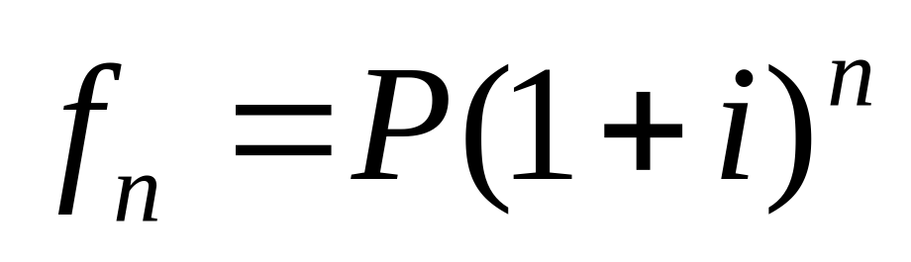
ACCT 201 ACCT 201 ACCT 201
Simply use this formula.
ACCT 201 ACCT 201 ACCT 201

Slide 21
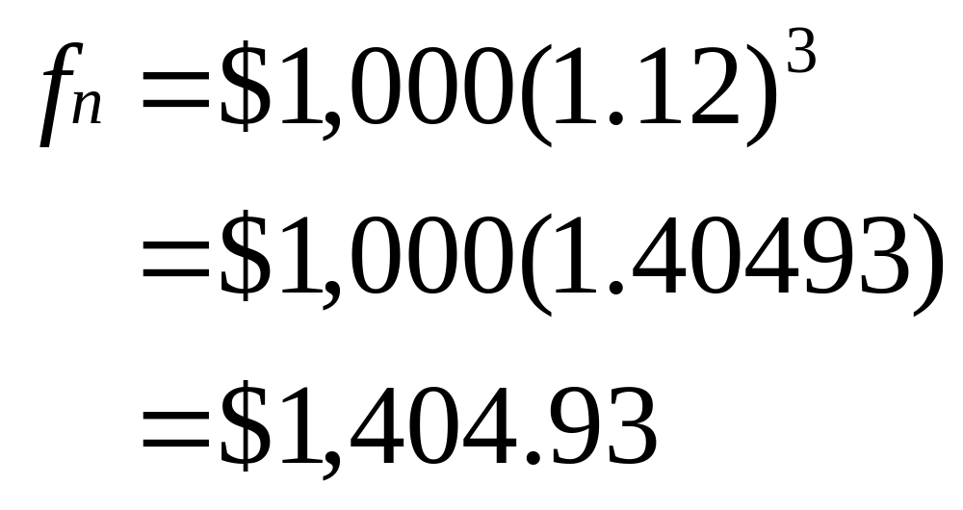
ACCT 201 ACCT 201 ACCT 201
ACCT 201 ACCT 201 ACCT 201

Slide 22
The Power of Compounding
ACCT 201 ACCT 201 ACCT 201
ACCT 201 ACCT 201 ACCT 201

Slide 23
Compound Interest
Simple Interest
Difference
$404.93
$360.00
$44.93
The Power of Compounding

Slide 24
Manhattan Island was purchased in 1624 for $24. At 7% compounded annually, that $24 investment would be worth . . .
ACCT 201 ACCT 201 ACCT 201
$24(1.07)373 =
$1,787,347,000,000
ACCT 201 ACCT 201 ACCT 201

Slide 25

That’s the number of times interest is compounded in one year.
What do we mean by frequency of compounding?
So, annual compounding is once per year. Right?

Slide 26
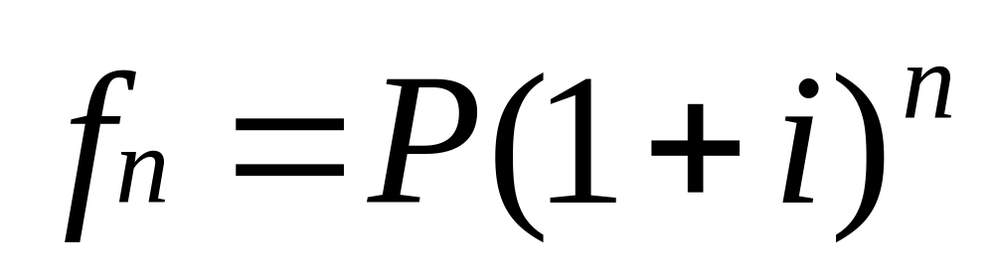
ACCT 201 ACCT 201 ACCT 201
Divide “i” by the frequency of compounding.
Multiply “n” by the frequency of compounding.
ACCT 201 ACCT 201 ACCT 201

Slide 27
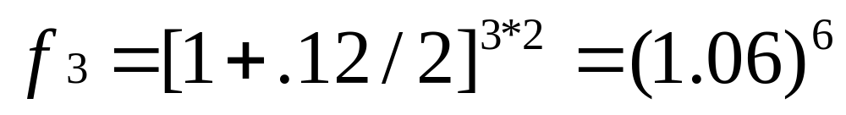

ACCT 201 ACCT 201 ACCT 201
  For example, if Aunt Minnie wanted semiannual compounding on your loan the equation would be adjusted as follows . . .
ACCT 201 ACCT 201 ACCT 201

Slide 28
ACCT 201 ACCT 201 ACCT 201
OK Prof! So, how can I use this stuff?
ACCT 201 ACCT 201 ACCT 201

Slide 29
ACCT 201 ACCT 201 ACCT 201
Thanks for asking!
There are four time value of money problems,
ACCT 201 ACCT 201 ACCT 201

Slide 30


Future Value Scenarios . . .
Future value of a single cash flow.
Future value of an annuity

Slide 31


Future Value Scenarios . . .
Present value of a single cash flow.
Present value of an annuity

Slide 32
ACCT 201 ACCT 201 ACCT 201
Let’s
At Present Value
ACCT 201 ACCT 201 ACCT 201

Slide 33
The Concept of Future Value
Today . . .
Future . . .
Add interest at interest rate “i” for “n” periods.
ACCT 201 ACCT 201 ACCT 201

Slide 34
The Concept of Present Value
Today . . .
Future . . .
Deduct interest at interest rate “i” for “n” periods.
ACCT 201 ACCT 201 ACCT 201

Slide 35
ACCT 201 ACCT 201 ACCT 201
Present value of a single cash flow.
ACCT 201 ACCT 201 ACCT 201

Slide 36
Present Value - An Example
XYX Corporation plans to give an employee a $10,000 bonus five years from now at the time of retirement.

Slide 37
Present Value - An Example
The company would like to immediately invest the required amount at 10% per annum compounded annually.
How much must the company invest today in order to have $10,000 five years from today?

Slide 38
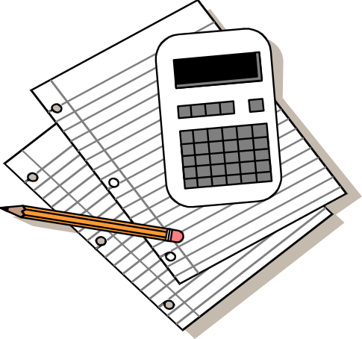

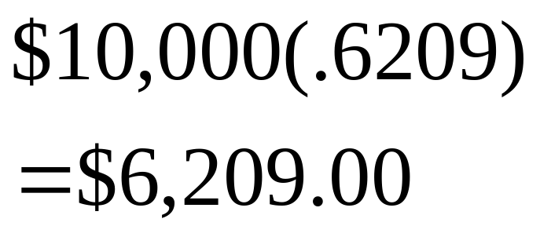

Present Value: An Example
Look at PV of $1 Table
  n = 5
  i = 10
Factor = .6209
Calculate the PV
ACCT 201 ACCT 201 ACCT 201

Slide 39
Compounding Illustrated
Future Value $6,209.00 for 5 years @ 10% compounded annually

Slide 40
Compounding Illustrated – Future Value
$6,209.00 x 1.10 ----------- $6,820.90
$6,829.90 x 1.10 ----------- $7,512.89
$7,512.89 x 1.10 ----------- $8,264.18
$8,264.18 x 1.10 ----------- $9,090.60
$9,090.60 x 1.10 ----------- $9,999.66
Add interest for “5” periods at 10%.
ACCT 201 ACCT 201 ACCT 201

Slide 41
Reverse Compounding Illustrated
Present Value $10,000.00 for 5 years @ 10% compounded annually

Slide 42
Compounding Illustrated – Present Value
$6,830.13 -----------1.10 $6,209.21
$7,513.15 -----------1.10 $6,830.13
$8,264.44 -----------1.10 $7,513.15
$9,090.91-----------1.10 $8,264.44
$10,000.00 ------------ 1.10 $9,090.91
Deduct interest for “5” periods at 10%.
ACCT 201 ACCT 201 ACCT 201

Slide 43
ACCT 201 ACCT 201 ACCT 201
Present value of an annuity
ACCT 201 ACCT 201 ACCT 201

Slide 44

Present Value of an Annuity
The Present Value of an Annuity :
  is the estimated value today of a series of uniform, periodic payments to be received in the future.
Notes:
When a series of uniform payments are expected to be received for a certain number of years into the future, such as a retirement pension, the recipient may be interested in knowing how much to accept as a lump sum payment in lieu of the periodic payments.

Slide 45
Present Value of an Annuity
The amounts to be received are adjusted . . .
  by deducting interest at the rate of “i” for “n” periods.
Notes:
When a series of uniform payments are expected to be received for a certain number of years into the future, such as a retirement pension, the recipient may be interested in knowing how much to accept as a lump sum payment in lieu of the periodic payments.

Slide 46
PVOA - An Example . . .
James Stinton, at 70 years of age, is retiring from his job. He must choose between . . .
  receiving $10,0000 per annum for 15 years, or
  accepting a lump-sum payment of $80,000.

Slide 47
PVOA - An Example . . .
Mr. Stinton . . .
  Believes he can invest the $80,000 at a 10% return, compounded annually, and
  He will withdraw $10,000 each year for his personal use.

Slide 48
PVOA - An Example . . .
Should he accept the lump sum of $80,000, or the annual payments of $10,000 for 15 years?

Slide 49
ACCT 201 ACCT 201 ACCT 201
Hmmmm. These two scenarios don’t seem to be directly comparable.
ACCT 201 ACCT 201 ACCT 201

Slide 50

ACCT 201 ACCT 201 ACCT 201
It seems like we’re comparing apples and oranges.
ACCT 201 ACCT 201 ACCT 201

Slide 51
PVOA - An Example . . .
In order to compare apples to apples, we need to compare their relative values at any point in time . . .
Time zero - (now, i.e., the present) is best.

Slide 52
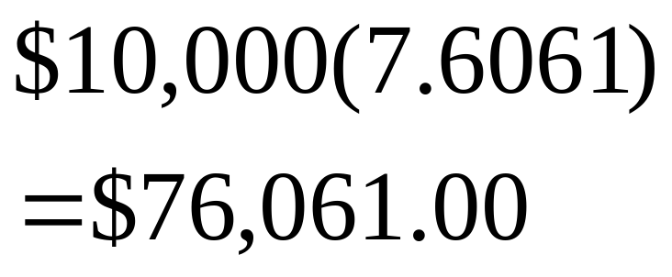
Present Value: An Example
Look at PV of an annuity of $1 Table
  n = 15
  i = 10
Factor = 7.6061
Calculate the PV
ACCT 201 ACCT 201 ACCT 201

Slide 53
Thanks, I’m pretty much indifferent between cash now and the annuity.
Congratulations on your retirement Mr. Stinton. Here’s $76,061.
$

Slide 54
Thanks. I’m not indifferent now. The $80,000 cash up front is a
better deal for me.
Congratulations on your retirement Mr. Stinton. Here’s $80,000.
$

Slide 55
Non-Uniform Periodic Payments
When the annual periodic payments are not uniform, the present value of the payments must be computed individually using Table 1.

